Slide 1
Praise Looks Good on You
The power of Praise

Slide 2
Prayer
Father we come humbly and gratefully into Your presence. We seek first your forgiveness for sins known and unknown. We thank you for allowing us to be here in this present hour to seek a better understanding of you. I ask specifically for You to guide my lips to say only what you would desire. I pray that they are never impressed by me but only blessed by thee. Give these your people an ear to hear, a mind to understand, and a heart to receive so that they may love you more dearly, see you more clearly, and follow you more nearly. We ask this in the mighty name of Jesus, amen.

Slide 3
INTRODUCTION
T.O.IY. (FB post Tae Tae)
Mental Exercise Activities

Slide 4
Question 1:
Is it legal for a man in California to marry his widow's sister? Why?

Slide 5
Answer 1:
NO, if he has a widow, then he is dead!

Slide 6
Question 2:
How far can a dog run into the woods?

Slide 7
Answer 2:
Halfway; after that he is running “out” of the woods.

Slide 8
Question 3:

Slide 9
Answer 3:
Travel overseas

Slide 10
Last one:

Slide 11
Answer:
A Friend in Need

Slide 12
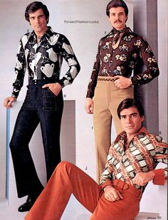
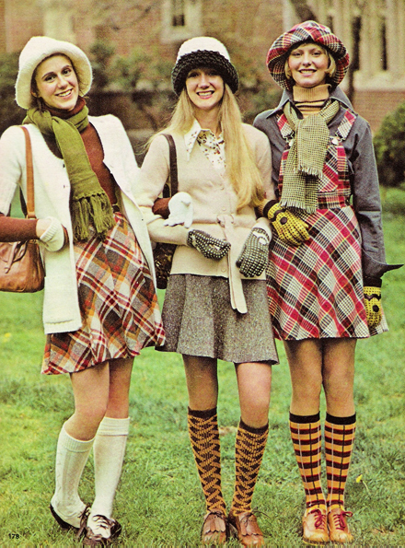
Something to think about: Back-to-school stuff
70’S

Slide 13
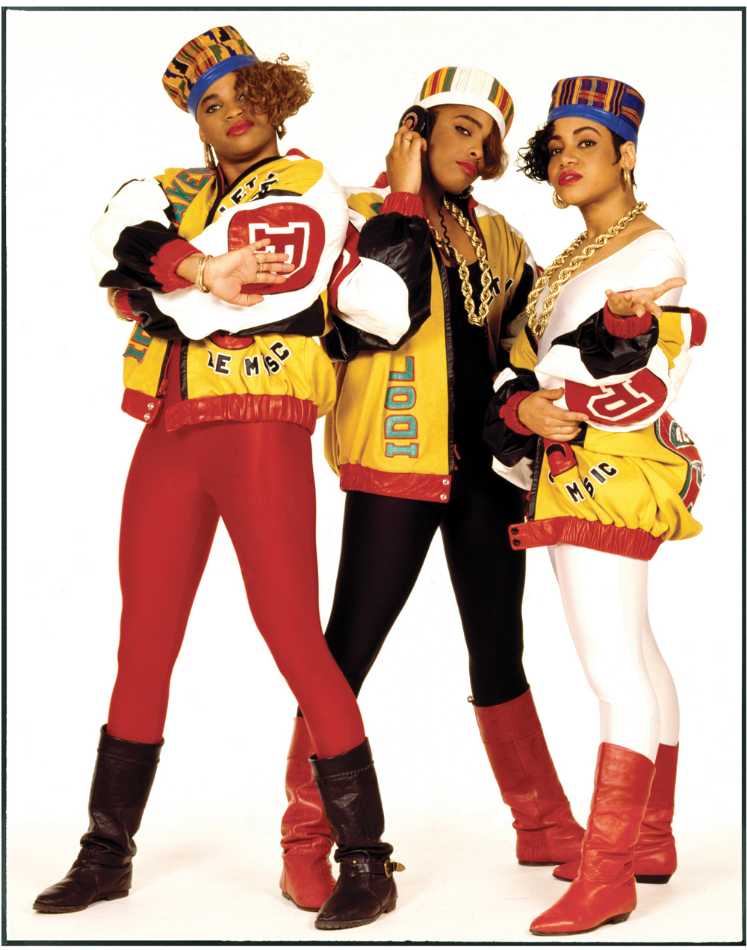
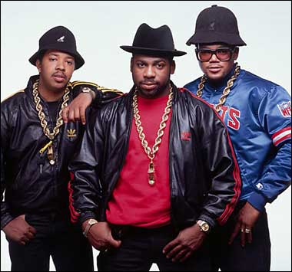
Something to think about: Back-to-school stuff
80’S

Slide 14
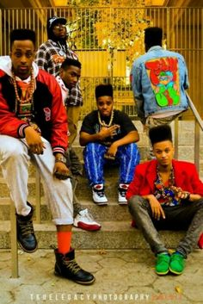
Something to think about: Back-to-school stuff
90’S

Slide 15
JUST BE YOURSELF! IT’S ALL ABOUT PERSPECTIVE…
But, there is one thing that looks good on everyone, praise! Put on your garment of praise…

Slide 16
Acts 16:22-25
²² The crowd also joined in the attack against them, and the chief magistrates tore their robes off them and ordered that Paul and Silas be beaten with rods. ²³ After striking them many times [with the rods], they threw them into prison, commanding the jailer to guard them securely. ²⁴ He, having received such a [strict] command, threw them into the inner prison (dungeon) and fastened their feet in the stocks [in an agonizing position].
²⁵ But about midnight when Paul and Silas were praying and singing hymns of praise to God, and the prisoners were listening to them; ²⁶ suddenly there was a great earthquake, so [powerful] that the very foundations of the prison were shaken and at once all the doors were opened and everyone’s chains were unfastened.

Slide 17
ACTS 16:27-33
²⁷ When the jailer, shaken out of sleep, saw the prison doors open, he drew his sword and was about to kill himself, thinking that the prisoners had escaped. ²⁸ But Paul shouted, saying, “Do not hurt yourself, we are all here!” ²⁹ Then the jailer called for torches and rushed in, and trembling with fear he fell down before Paul and Silas, ³⁰ and after he brought them out [of the inner prison], he said, “Sirs, what must I do to be saved?”
³¹ And they answered, “Believe in the Lord Jesus [as your personal Savior and entrust yourself to Him] and you will be saved, you and your household [if they also believe].” ³² And they spoke the word of the Lord [concerning eternal salvation through faith in Christ] to him and to all who were in his house. ³³ And he took them that very hour of the night and washed their bloody wounds, and immediately he was baptized, he and all his household.

Slide 18
ACTS 16:34-39
³⁴ Then he brought them into his house and set food before them, and rejoiced greatly, since he had believed in God with his entire family [accepting with joy what had been made known to them about the Christ].
³⁵ Now when day came, the chief magistrates sent their officers, saying, “Release those men.” ³⁶ And the jailer repeated the words to Paul, saying, “The chief magistrates have sent word to release you; so come out now and go in peace.” ³⁷ But Paul said to them, “They have beaten us in public without a trial, men who are Romans, and have thrown us into prison; and now they are sending us out secretly? No! Let them come here themselves and bring us out!” ³⁸ The officers reported this message to the chief magistrates, and ^{[g]}when they heard that the prisoners were Romans, they were frightened; ³⁹ so they came [to the prison] and appealed to them [with apologies], and when they brought them out, they kept begging them to leave the city.

Slide 19
What does this all mean?
Praise has power!
Praise can change people’s hearts
Praise can lift heaviness off of you
Your friends can be blessed by your praise
Even if the situation is bleak, praise is what I do!

Slide 20
Questions, Comments, Concerns?

