Slide 1
WHISPER A PRAYER, RECEIVE GOD’S GRACE
I Kings 9:11-13 (AMPC)
Romans 6:23 (AMPC)

Slide 2
PRAYER
Father, we thank you and come to you most humbly and graciously asking to forgive us our sins of omission and commission. We thank you for allowing us to be here and thank you in advance for allowing us to return to our destinations safely. Father, I ask that you let these, your people, be blessed by thee and never impressed by me. Let the words of my mouth and the meditations of my heart be acceptable in your sight, oh Lord, my strength and my redeemer. Give each one under the sound of my voice an ear to hear, a mind to receive, and a heart to believe; so that they see you more clearly, love you more dearly, and follow you more nearly. These things we ask in Jesus’ name, amen.

Slide 3
PLAN OF ACTION
Stretch your brain
Tales Of Interesting Youth- PERFECTION
“Prayer/Grace” lesson
Q & A

Slide 4
STRETCH YOUR BRAIN
1.
You can see me in water, but I never get wet. What am I?
Notes:
4

Slide 5
ANSWER 1
A REFLECTION…
Notes:
2

Slide 6
STRETCH YOUR BRAIN
2. What has cities, but no houses; forests, but no trees; and water, but no fish?
Notes:
3

Slide 7
ANSWER 2
A MAP
Notes:
1

Slide 8
STRETCH YOUR BRAIN
3. Two people are born at the same moment, but they don't have the same birthdays. How could this be?
Notes:
2

Slide 9
ANSWER 3
They are born in different time zones

Slide 10
STRETCH YOUR BRAIN
4. There is a man in a 4 story building. He jumps out of the window and is unharmed. He used no padding, and had no harm done. How?
Notes:
3

Slide 11
ANSWER 4
HE JUMPED OUT ON THE GROUND FLOOR

Slide 12
STRETCH YOUR BRAIN (LAST ONE)
5. A man leaves home. He goes a little ways and turns a corner. He goes a while and turns another corner. Soon, he turns one more corner. As he's returning home, he sees two masked men. Who are they?
Notes:
3

Slide 13
ANSWER 5
A CATCHER AND AN UMPIRE—HE’S PLAYING BASEBALL

Slide 14
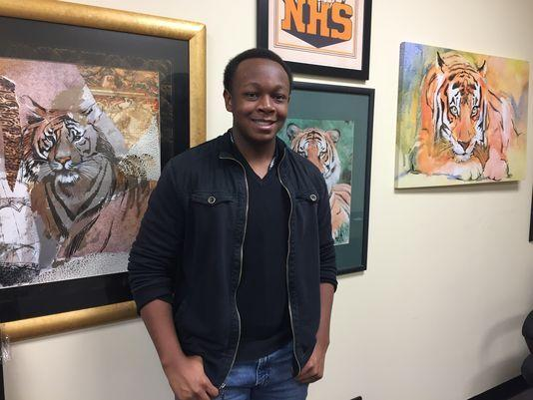
T.O.I.Y.
Louisiana teen gets perfect ACT score
"Manage your time wisely because if you run out of time that directly affects your score. If you don't get to questions, then you can't answer them," he said.

Slide 15
OK WHERE DO WE START?
My Story…
Excited about my news
The other person wasn’t responding
I was frustrated because it seemed only one-way
Hung up and tried again, this time they could hear
Then it hit me…prayer sometimes feels the same way.
What about you?

Slide 16
I KINGS 19:11-13 (AMPC)
¹¹ And He said, Go out and stand on the mount before the Lord. And behold, the Lord passed by, and a great and strong wind rent the mountains and broke in pieces the rocks before the Lord, but the Lord was not in the wind; and after the wind an earthquake, but the Lord was not in the earthquake;
¹² And after the earthquake a fire, but the Lord was not in the fire; and after the fire [a sound of gentle stillness and] a still, small voice.
¹³ When Elijah heard the voice, he wrapped his face in his mantle and went out and stood in the entrance of the cave. And behold, there came a voice to him and said, What are you doing here, Elijah?

Slide 17
WHAT IS THIS SAYING?
In this story, Elijah was searching for God. First, he looked for Him in a windstorm, then a powerful fire, but God was not in either of those things.
This was a very significant experience for Elijah because God had established a pattern of appearing in these ways over hundreds of years when communicating with His people.
God appeared in a burning bush to Moses in Exodus 3 and in billows of smoke on Mt. Sinai in Exodus 19 with winds that shook the ground.
Despite these patterns, Elijah does not feel God’s presence until he hears the faintest of whispers.

Slide 18
HOW DO YOU THINK GOD IS COMING TO YOU?
Do you ever find yourself expecting God’s voice to come in windstorms and explosive fireworks?
I know that when I am desperately seeking God in prayer, I most often want to hear or see His response in very obvious, visible ways.
If I am sick, I pray for healing and want to feel better immediately.
If I need help with a problem, I want a clear solution.
If I am in emotional pain, I want God make the pain go away.
Sometimes, though, I feel the same way I did during my dropped call

Slide 19
REMEMBER THAT GOD ANSWERS IN HIS WAY
I talk to God in prayer and feel and see no change.
It is in those moments that I need to remember that God’s voice sometimes comes in a gentle whisper.
He doesn’t always work in dramatic ways.
Sometimes it is in the little things that God moves the most.
I might not feel healthy right away, but He may nudge me toward the help that I need.
Maybe the connection hasn’t been lost.
Perhaps you are just not listening carefully enough.

Slide 20
REMEMBER THAT GOD ONLY ANSWERS US BECAUSE OF HIS GRACE!
G- Granting of
R- Redemptive
A- Authority over
C- Circumstances to
E- Exercise Righteousness
- Grace is the divine empowerment to effectively execute and complete your assignment to fulfill the expansion of the Kingdom of God and for experiencing and enjoying the Kingdom lifestyle.
Keys:
Tools- resources
Techniques- skills
Tenacity- endurance

Slide 21
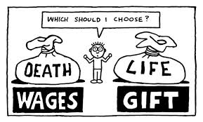
ROMANS 6:23 (AMPC)
²³ For the wages which sin pays is death, but the [bountiful] free gift of God is eternal life through (in union with) Jesus Christ our Lord.
From the moment you drew your first breath as a baby, you were born with a problem. You entered a world covered with a thick, sticky substance that makes everything filthy. It coats every person who is alive now, just as it has everyone from the beginning of time. This substance is called sin.
This sin separates us from God. God wants to be in a close relationship with us, but this sin separates us all from him.
“For the wages which sin pays is death…”- Those are perhaps the most depressing eight words in the Bible.

Slide 22
WHO BETTER TO GET A GIFT FROM THAN GOD?
What do I mean?
Our sad human story could have ended with a period after those first seven words. “The wages of sin is death.” Period. We have earned it.
God, however, says, “Wait a second, the sentence isn’t over.” He added a comma.
The story doesn’t end. Instead of receiving what we deserve, we are given the choice of a free gift.
We know what happens if we don’t take the gift, and we already know what’s in the gift: life forever with Jesus!
Grace is the gift that says, “I know you don’t deserve this, but I’m yours.”

Slide 23
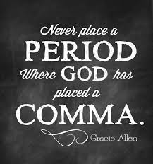
BUT GOD!
This “death” is what we deserve for being born with our sin problem. It basically means we deserve to be separated from God forever.
But God wants to be close to us. He wants us to enjoy a relationship with Him. He wants to guide our lives and speak to us. He wants to be our best friend.
So, where does grace come in to play?
Thank God (literally) that those seven words were only the first half of the verse!
“…but the [bountiful] free gift of God is eternal life through (in union with) Jesus Christ our Lord.”
Grace is the comma instead of the period.

Slide 24
ANY ADDITIONAL QUESTIONS?

