Slide 1
LASER FOCUS “Focus like a laser, not a flashlight.”- Michael Jordan
Hebrews 12:1-3 (MSG)
Genesis 37-50 (AMPC)

Slide 2
PRAYER
Father, we thank you and come to you most humbly and graciously asking to forgive us our sins of omission and commission. We thank you for allowing us to be here and thank you in advance for allowing us to return to our destinations safely. Father, I ask that you let these, your people, be blessed by thee and never impressed by me. Let the words of my mouth and the meditations of my heart be acceptable in your sight, oh Lord, my strength and my redeemer. Give each one under the sound of my voice an ear to hear, a mind to receive, and a heart to believe; so that they see you more clearly, love you more dearly, and follow you more nearly. These things we ask in Jesus’ name, amen.

Slide 3
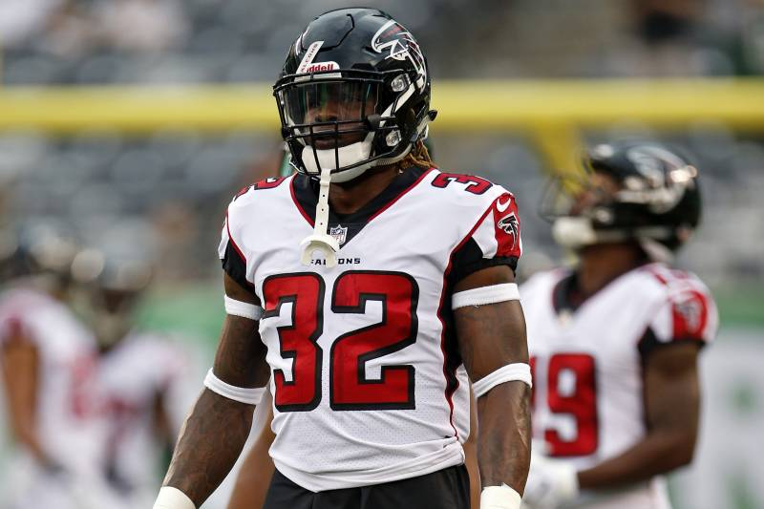
T.O.I.Y.
Former Falcons RB Justin Crawford Arrested on Incest, Sodomy, Enticement Charges

Slide 4
OK WHERE DO WE START?
Has it ever just seemed when things are going along well, there is just ALWAYS SOMETHING that goes wrong? Another obstacle to face?
Think about it like learning to drive…there is a lot to learn like bad weather driving, rules of the road, and parallel parking. But what about the stuff that is not in the manuals?
Can you guess what the number 1 cause of accidents is?
DISTRACTED DRIVING!!!!

Slide 5
DISTRACTED DRIVING
When a driver is distracted, he or she can cause an accident and endanger not only their own life, but also the lives of others on the road. Have you ever heard of the word “rubbernecking?”
That’s when people just have to look at something going on outside of the car, on the side of the road. Rubbernecking can lead to accidents or cause traffic to be backed up for hours just because one person had to slow down and see what was going on outside their car.
Unfortunately, there’s a danger that is far more likely to cause you distraction on the road, something almost all of us carry around with us all the time – cell phones. People who use their phone while driving are almost three times more likely to get into an accident than those who don’t.
Just like there are distractions when driving, we have distractions in our spiritual lives too.

Slide 6
Hebrews 12:1-3 (MSG)
Do you see what this means—all these pioneers who blazed the way, all these veterans cheering us on? It means we’d better get on with it. Strip down, start running—and never quit! No extra spiritual fat, no parasitic sins.
Keep your eyes on Jesus, who both began and finished this race we’re in. Study how he did it. Because he never lost sight of where he was headed—that exhilarating finish in and with God—he could put up with anything along the way: Cross, shame, whatever. And now he’s there, in the place of honor, right alongside God.
When you find yourselves flagging in your faith, go over that story again, item by item, that long litany of hostility he plowed through. That will shoot adrenaline into your souls!

Slide 7
WHAT DOES THIS MEAN?
Our goal as Christians is to “look only to Jesus”…to focus on our relationship with God, but it’s so easy to get distracted.
The Bible tells us to “strip down”- remove parasitic sins or spiritual fat! In other words, don’t get distracted from your personal relationship with Jesus.
Distractions come in many forms: sin, problems, successes, friends, family, school, girlfriends/boyfriends, etc.
Having a quiet time where you dedicate a chunk of your day to being with God is a great place to start. It gives your relationship with God a solid foundation.

Slide 8
BUT HOW DO YOU FOCUS DURING THE REST OF YOUR LIFE OUTSIDE OF CHURCH?
You spend about 7 hours a day at school. You might play sports or do some other after school activity that takes up a few hours a week.
You’re on your phone texting, watching YouTube videos, snap chatting, and on Instagram.
The key is to look for what God is doing in your life and those around you.
Be aware that God is always doing something in your life. He’s always up to something good. Just ask God to show you what he’s doing, then be on the lookout for what that might be. Trust your gut. Trust the Holy Spirit’s soft voice within you. Be willing to respond to whatever it is that he’s showing you.
Even in hard times, the Holy Spirit can work through them to get to you! Trust Him!

Slide 9
The distraction is sometimes the way
Let’s take a look at the life of Joseph. Joseph was misunderstood by his family, rejected by his brothers and sold into slavery. He became the slave of Potiphar, an officer to the king of Egypt (the Pharaoh).
Genesis 39:3-6 -And his master saw that the Lord was with him and that the Lord made all that he did to flourish and succeed in his hand.
⁴ So Joseph pleased [Potiphar] and found favor in his sight, and he served him. And [his master] made him supervisor over his house and he put all that he had in his charge.
⁵ From the time that he made him supervisor in his house and over all that he had, the Lord blessed the Egyptian’s house for Joseph’s sake; and the Lord’s blessing was on all that he had in the house and in the field.
⁶ And [Potiphar] left all that he had in Joseph’s charge and paid no attention to anything he had except the food he ate. Now Joseph was an attractive person and fine-looking.

Slide 10
Joseph remained loyal to God!
The situation forced him to focus on God, who proved himself faithful to Joseph.
God gave him favor with Potiphar, who put Joseph in charge of his entire household.
This was a big deal for a servant. It was an honor and privilege to be in that position.
Then, things took a dive for the worse.
He was falsely accused by Potiphar’s wife and put in jail, but Joseph continued to focus on God.
Here’s what happened next.

Slide 11
Genesis 39:21-23 (AMPC)
²¹ But the Lord was with Joseph, and showed him mercy and loving-kindness and gave him favor in the sight of the warden of the prison.
²² And the warden of the prison committed to Joseph’s care all the prisoners who were in the prison; and whatsoever was done there, he was in charge of it.
²³ The prison warden paid no attention to anything that was in [Joseph’s] charge, for the Lord was with him and made whatever he did to prosper.

Slide 12
WHAT IS THIS SAYING?
God continued to show up in Joseph’s life.
The very thing that could have distracted Joseph from God, being falsely accused and put in jail, was just another opportunity for God to show up.
Joseph interprets a dream for some people close to the king, and almost gets a “get out of jail free card” because of it.
Unfortunately, he remains in jail for another 2 years.
The Pharaoh has a bad dream, and Joseph is called in to interpret it.
The dream meant there will be 7 years of plenty food, followed by 7 years of famine.
Then, check out what the Pharaoh told him:

Slide 13
Genesis 41:39-40
³⁹ And Pharaoh said to Joseph, Forasmuch as [your] God has shown you all this, there is nobody as intelligent and discreet and understanding and wise as you are.
⁴⁰ You shall have charge over my house, and all my people shall be governed according to your word [with reverence, submission, and obedience]. Only in matters of the throne will I be greater than you are.

Slide 14
Joseph literally went from jail to being the second in charge of Egypt.
He was later reunited with his family, and found it in his heart to forgive this brothers. Wow. What an amazing story!
Joseph’s story reminds us that what appear to be distractions away from God can actually bring us closer to God.
The distraction may be the way. The problem may be the way.
Any one of these events could have turned Joseph away from God.
He could have become bitter and angry towards his brothers and the unfair circumstances.
However, he chose to let those circumstances bring him closer to God.
What problems or distractions are you facing that could bring you closer to God?

Slide 15
What is FOCUS?
Focus is:
F = Fixing
O = Our
C = Concentration
U = Upon
S = Specific
requirements
Focus is fearlessly facing every challenge by fixing on the requirements for success in the expansion of the Kingdom of God and for experiencing the enjoyment of a Kingdom lifestyle
3 Laws of Focusing:
Center – vision; the goal
Concentration – perception;
motivation
Convergence – come together

Slide 16
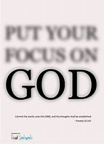
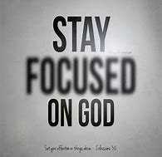
Perspective…

Slide 17
ANY ADDITIONAL QUESTIONS?

